Slide 1
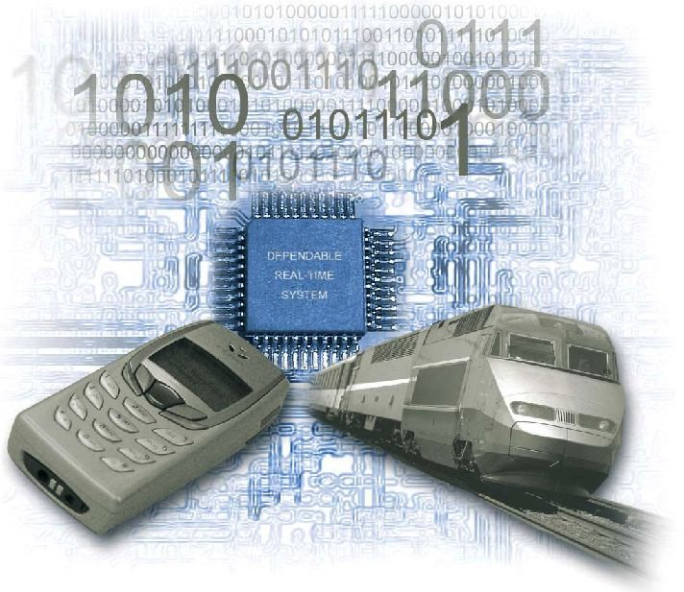

An introduction to Embedded Systems

Slide 2
About the Trainers
Deepak Nayak
20+ years in Embedded
R&D
Projects, Programs, Products
Delivery
Startups
Areas
Consumer AV (DSP, Multimedia)
Smart Lighting
HVAC Energy
Storage
Data Centre / Cloud
Strong innovation mindset
Patents, trade secrets
AI/ML
Rushikesh Kulkarni
3+ years of Training
Embedded courses
PG Diploma
3+ years of Industry
Electronics
Appliances
Automotive
Areas:
Hardware
Microcontrollers
Robotics

Slide 3

OPEN QUESTION!
What does this picture mean?
What is special about what this guy has done?
How is this Embedded Course related to this guy?!

Slide 4
THE WORLD TODAY
EMBEDDED plays a central role in today’s world
Professional life
Desktops, PCs, Notebooks
Smartphones
Financial life
Smartphones
ATM
PAYTM/UPI/Online transfer, Online banking
Personal life
Smartphones
Calling, Video-Calling
Travel
Ola/Uber, IRCTC/Cleartrip/Makemytrip
Shopping
Flipkart, Amazon, Myntra
Now add pandemic and lockdown to the picture!

Slide 5
AGENDA
System
Embedded System
Components
Classifications
Hardware
Processors
Other Components
Software
Applications
Automotive Domain
5

Slide 6
SYSTEM
What is a system?
- A way of working / organizing / doing one or more tasks according to a fixed plan, program or set of rules.
- An arrangement in which all its units assemble and work together according to the plan / program / rules.
6

Slide 7
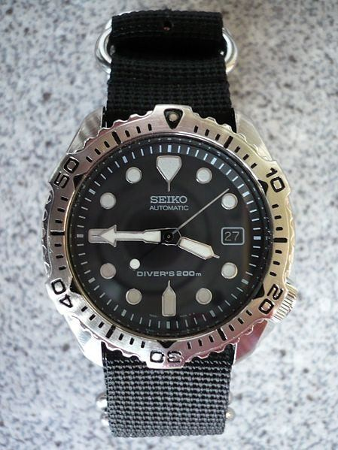
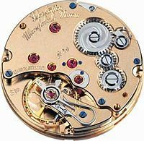
SYSTEM EXAMPLE #1
WATCH
It is a time-display SYSTEM
Parts: Hardware, Needles, Battery, Dial, Chassis, Strap
Rules:
All needles move clockwise only
A thin needle rotates every second
A long needle rotates every minute
A short needle rotates every hour
All needles return to the original position after 12 hours
7

Slide 8
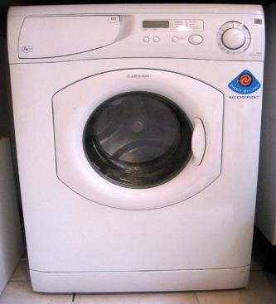
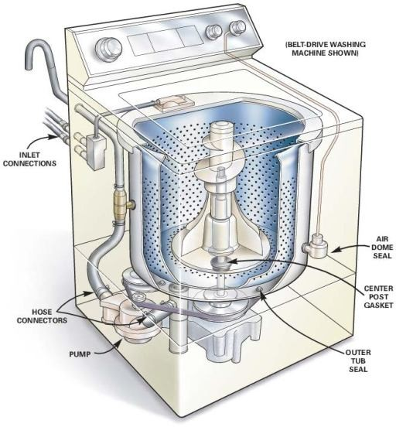
SYSTEM EXAMPLE #2
WASHING MACHINE
It is an automatic clothes washing SYSTEM
Parts: Status display panel, Switches, Dials, Motor,
Power supply, Inner-water level sensor
Rules:
1.Wash clothes - spin
2.Rinse clothes
Dry clothes
Indicate “wash is over" by sound/blinking
Each step displays the process stage
If interrupted, execute only the remaining
8

Slide 9
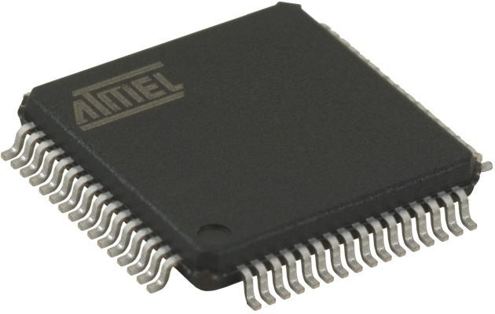
EMBEDDED SYSTEM
An Embedded System is one that has computer hardware with software embedded in it.
SOFTWARE PROGRAM
#include <18f84520.h>
#use delay (clock=20000000) #byte PORTB=6
main()
{
set_tris_b(0);
portb=255; //decimal
HARDWARE
delay_ms(1000); portb=0x55; delay_ms(1000);
}
//hexadecimal
6

Slide 10
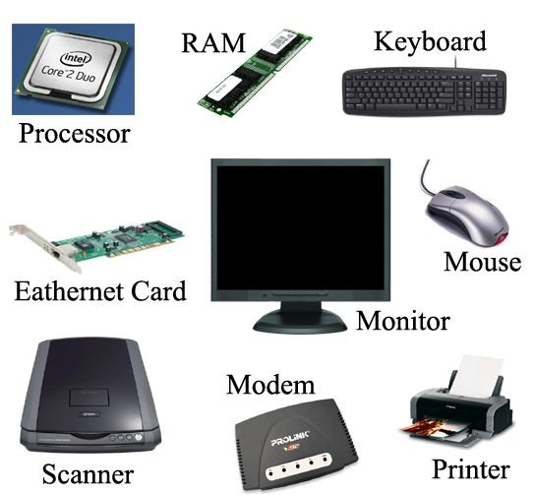
COMPUTER HARDWARE
Microprocessor
Memory
(Primary and Secondary)
(RAM, ROM and caches)
Input Units
(Keyboard, Mouse, Scanner, etc.)
Output Units
(Monitor, printer, etc.)
Networking Units
(Ethernet Card, Drivers, etc.)
I/O Units
(Modem, Fax cum Modem, etc.)

Slide 11
EMBEDDED SYSTEM HARDWARE
Hardware
Processor, Timers, Interrupt controller, I/O Devices, Memories, Ports, etc.
Application Software
Software that performs the series of tasks or multiple tasks.
Real Time Operating System (RTOS)
It supervises the application software - sets the rules during the execution of the application programs.
A small scale embedded system may not need an RTOS.

Slide 12
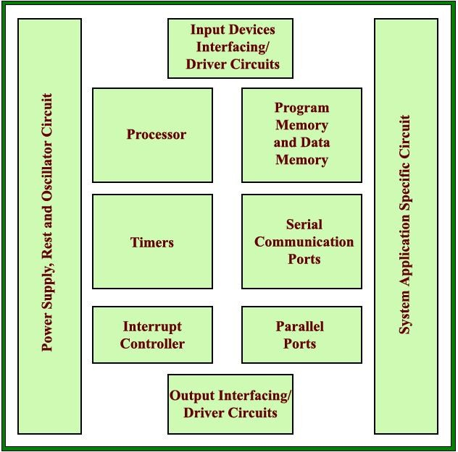
EMBEDDED SYSTEM BLOCK DIAGRAM

Slide 13
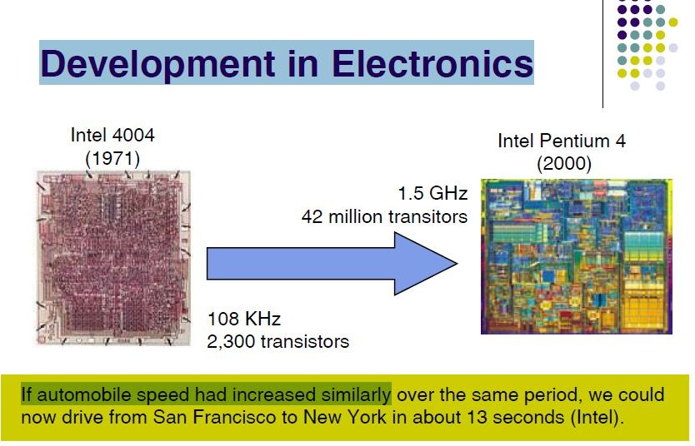

Slide 14
EMBEDDED SYSTEM CONSTRAINTS
Embedded system software is designed to within
3 primary constraints:
Limited processor speed (kHz, MHz)
Low system memory (kB, MB)
Low power dissipation
When running the system continuously in cycles of wait for events, run, stop and wakeup.

Slide 15
How are
EMBEDDED SYSTEMS
Different?
Real-time operation
Size
Cost
Reliability
Safety
Power
Security

Slide 16
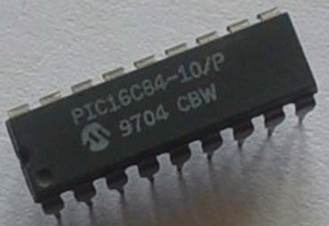
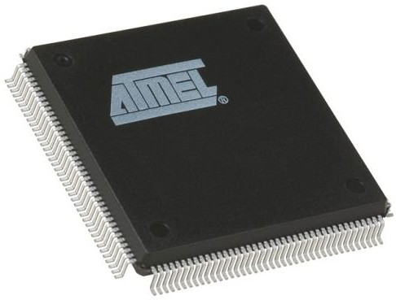
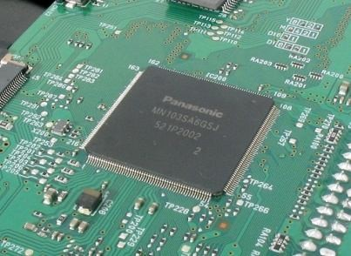
EMBEDDED SYSTEM CLASSIFICATIONS
Small Scale Embedded System
Medium Scale Embedded System
Sophisticated Embedded System

Slide 17
SMALL SCALE EMBEDDED SYSTEM
Single 8-bit or 16-bit Microcontroller.
Low hardware and software complexity.
May be battery operated.
“C” is used for developing these system.
Programming tools:
Editor, Assembler and Cross-Assembler

Slide 18
MEDIUM SCALE EMBEDDED SYSTEM
Single or few 16-bit or 3-bit microcontrollers or Digital Signal Processors (DSP) or Reduced Instructions Set Computers (RISC).
Medium hardware and software complexity.
Programming tools:
RTOS, Simulator, Debugger
Integrated Development Environment (IDE).

Slide 19
SOPHISTICATED EMBEDDED SYSTEM
Enormous hardware and software complexity
May need scalable processor or configurable processor and programming logic arrays (PLAs).
Constrained by the processing speed available in their hardware units.
Programming Tools:
Advanced Software Development IDEs

Slide 20
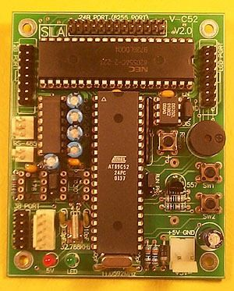
PROCESSOR
A Processor is the heart of the Embedded System.
For an embedded system designer knowledge of microprocessor and microcontroller is a must.
Two Essential Units: Control Unit (CU), Execution Unit (EU)
Operations Fetch Execute

Slide 21
VARIOUS PROCESSOR
General Purpose processor (GPP)
Microprocessor Microcontroller Embedded Processor Digital signal Processor
Application Specific System Processor (ASSP)
Multi Processor System using GPPs

Slide 22
MICROPROCESSOR
A microprocessor is a single chip semiconductor device, but not a complete computer.
Its CPU contains an ALU, a program counter, a stack pointer, some working register, a clock timing circuit and interrupt circuit on a single chip.
To make a complete computer, one must add memory usually ROM and RAM, memory decoder, an oscillator and a number of serial and parallel ports.

Slide 23
MICROCONTROLLER
A microcontroller is a functional computer system-on-a-chip. It contains a processor, memory, and programmable input/output peripherals.
Microcontrollers include an integrated CPU, memory (a small amount of RAM, program memory, or both) and peripherals capable of input and output.

Slide 24
VARIOUS MICROCONTROLLERS
INTEL
8031,8032,8051,8052,8751,8752
PIC
8-bit PIC16, PIC18
16-bit DSPIC33 / PIC24, PIC16C7x
Motorola
MC68HC11

Slide 25
DIGITAL SIGNAL PROCESSOR
DSP is a single chip VLSI computeunit
Includes
Computational capabilities of microprocessor
and
Multiply & accumulate units (MAC)
Applications such as image processing, audio, video & telecommunication processing systems
It is used for fast signal processing functions
Examples : TMS320Cxx, SHARC, Motorola 5600xx, ADI Blackfin

Slide 26
OTHER HARDWARE
Power Source
Clock Oscillator
Real Time Clock (RTC)
Reset Circuit, Power-up Reset and watchdog timer Reset
Memory
I/O Ports, I/O Buses
Interrupt Handler
DAC and ADC
LCD and LED Display
Keypad/Keyboard

Slide 27
SOFTWARE
SOFTWARE
SIMULATORS
Assembly
C /C++
Dot Net
Masm
MPLAB
COMPILER
MC18 KEIL

Slide 28
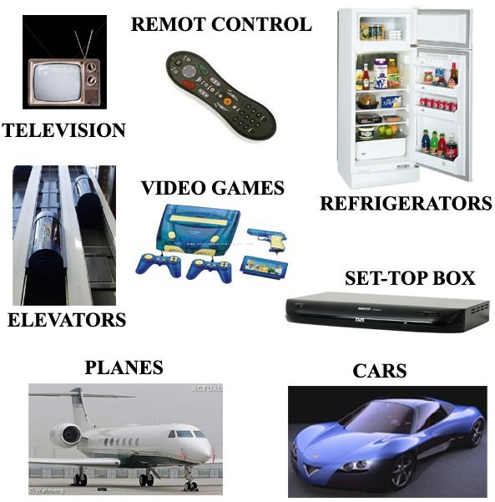
APPLICATIONS
Household appliances:
Microwave ovens, Television, DVD Players & Recorders
Audio players
Integrated systems in aircrafts and missiles
Cellular telephones
Electric and Electronic Motor controllers
Engine controllers in automobiles
Calculators
Medical equipments
Videogames
Digital musical instruments, etc.

Slide 29
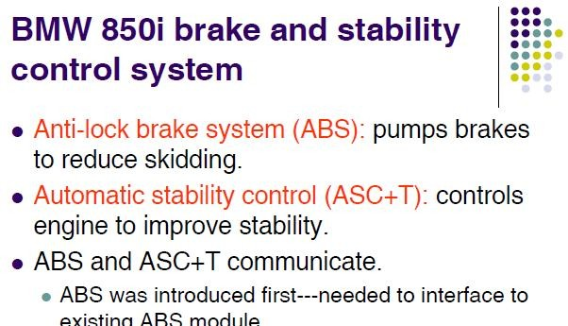

Slide 30
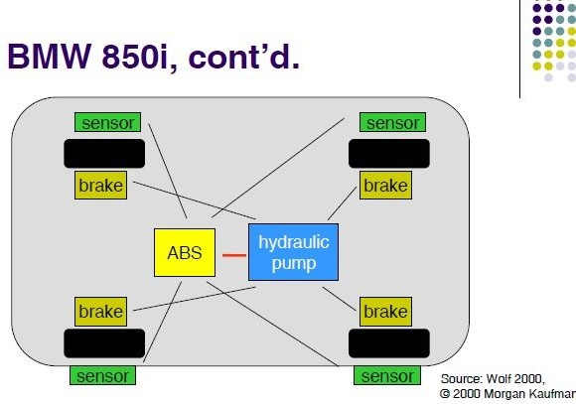

Slide 31
EMBEDDED AUTOMOTIVE SYSTEMS
Today’s high-end automobile may have 100 microprocessors
4-bit microcontroller checks seat belt
8-bit microcontrollers run dashboard devices
16/32-bit microprocessor controls engine

